Slide 1



ML PROJECT – HEART DISEASE CLASSIFICATION
UNDER THE GUIDANCE OF -
MR. PRANAV JAIPURKAR
M.E
KNOWLEDGE SOLUTION INDIA
SUBMITTED BY –
SWETA PADMA PRUSTY
COLLEGE : MATS UNIVERSITY
COURSE : B.TECH (HONS.) WITH SPECIALIZATION IN AI AND ML
BRANCH : COMPUTER SCIENCE ENGINEERING
SEMESTER : 2

Slide 2

CONTENTS
Introduction to Machine Learning
Python and Features of Python
Application of ML
Abstract
Chapters (Software libraries used)
K-NN Model Description
Testing
Data Set
Figures/Graphs
Inference
Conclusion

Slide 3
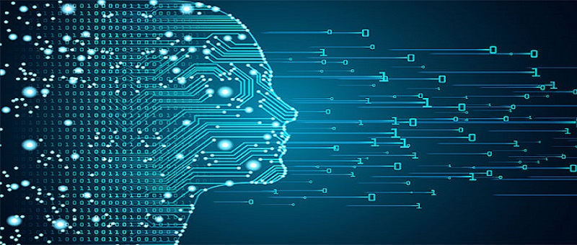
MACHINE LEARNING
Machine learning (ML) is the study of computer algorithms that improve automatically through experience and by the use of data. It is seen as a part of artificial intelligence. Machine learning algorithms build a model based on sample data, known as “training data” , in order to make predictions or decisions without being explicitly programmed to do so.
A subset of machine learning is closely related to computational statistics, which focuses on making predictions using computers; but not all machine learning is statistical learning.
The study of mathematical optimization delivers methods, theory and application domains to the field of machine learning.
Data Mining is a related field of study, focusing on exploratory data analysis through unsupervised learning.
Machine learning approaches are traditionally divided into three broad categories, depending on the nature of the "signal" or "feedback" available to the learning system:
Supervised Learning: The computer is presented with example inputs and their desired outputs, given by a "teacher", and the goal is to learn a general rule that maps inputs to outputs.
Unsupervised Learning: No labels are given to the learning algorithm, leaving it on its own to find structure in its input. Unsupervised learning can be a goal in itself (discovering hidden patterns in data) or a means towards an end(feature learning).
Reinforcement Learning: A computer program interacts with a dynamic environment in which it must perform a certain goal (such as driving a vehicle or playing a game against an opponent). As it navigates its problem space, the program is provided feedback that's analogous to rewards, which it tries to maximize.

Slide 4

Python and Features of Python
Python is a high-level, interpreted, interactive and object-oriented scripting language. Python is designed to be highly readable. It uses English keywords frequently where as other languages use punctuation, and it has fewer syntactical constructions than other languages. We have also used python in our ML model too.
FEATURES OF PYTHON :-
Easy to code
Free and Open Source
Object-Oriented Language
GUI Programming Support
High-Level Language
Extensible feature
Python is Portable language
Python is Integrated language
Interpreted Language
Large Standard Library
Dynamically Typed Language

Slide 5

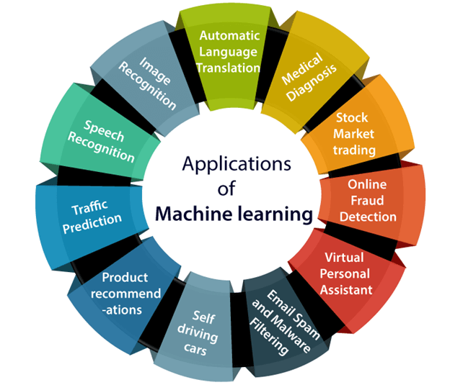
APPLICATION OF MACHINE LEARNING
Machine learning is a buzzword for today's technology, and it is growing very rapidly day by day. We are using machine learning in our daily life even without knowing it such as Google Maps, Google assistant, Alexa, etc. Below are some most trending real-world applications of Machine Learning:
Image Recognition.
Speech Recognition.
Traffic prediction.
Product recommendations.
Self-driving cars.
Email Spam and Malware Filtering.
Virtual Personal Assistant.
Online Fraud Detection.
Stock Market trading
Medical Diagnosis
Automatic Language Translation

Slide 6
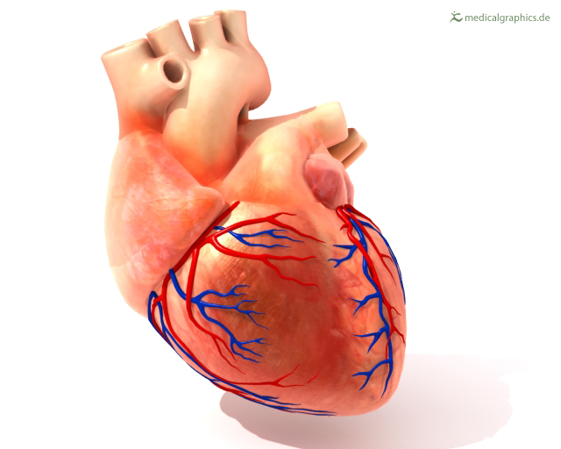
ABSTRACT
Heart Disease is the leading cause of death among all other diseases, even Cancer. Due to lack of resources in the Medical field, the prediction of heart disease occasionally may be a problem. Utilization of suitable technology can prove to be highly beneficial to the medical fraternity as well as the patients. The Machine Learning techniques can be very well adapted to do the prediction of heart disease among individuals.
In this project I have built a ML model, with the help of K-NN Classifier which helps us to predict the ‘target’ class for the heart disease and also plot the Confusion Matrix.We have imported various libraries and used their attributes in this project.We have used Python programming language for the execution of the whole Machine Learning Project.
Goal of this project:
To predict whether a patient should be diagnosed with Heart Disease. This is a binary outcome. Positive (+) = 1, patient diagnosed with Heart Disease Negative (-) = 0, patient not diagnosed with Heart Disease

Slide 7


CHAPTERS
Libraries are sets of routines and functions that are written in a given language. A robust set of libraries can make it easier for developers to perform complex tasks without rewriting many lines of code.
Machine learning is largely based upon mathematics. Specifically, mathematical optimization, statistics and probability. Python libraries help researchers/mathematicians who are less equipped with developer knowledge to easily “do machine learning”.
Below are some of the Machine Learning libraries used in this project –
Numpy - NumPy is a very popular python library for large multi-dimensional array and matrix processing, with the help of a large collection of high-level mathematical functions.
Pandas - Pandas is a very popular library that provides high-level data structures which are simple to use as well as intuitive.
Matplotlib for data visualization - It is a standard Python library for creating 2D plots and graphs.
Seaborn is a popular visualization library that builds on Matplotlib’s foundations. It is a higher-level library, meaning it’s easier to generate certain kinds of plots, including heat maps, time series, and violin plots.
Sklearn - Scikit-learn is a free software machine learning library for the Python Programming language. It features various classification, regression and clustering algorithms including Support Vector Machine, Random Forest and Gradient Boosting. K-means and DBSCAN, and is designed to interoperate with the Python numerical and scientific libraries Numpy and Scipy.

Slide 8

K-NN MODEL DESCRIPTION
K-Nearest Neighbour is one of the simplest Machine Learning algorithms based on Supervised Learning technique.
K-NN algorithm stores all the available data and classifies a new data point based on the similarity. This means when new data appears then it can be easily classified into a well suite category by using K- NN algorithm.
K-NN algorithm can be used for Regression as well as for Classification but mostly it is used for the Classification problems.
K-NN is a non-parametric algorithm, which means it does not make any assumption on underlying data.
It is also called a lazy learner algorithm because it does not learn from the training set immediately instead it stores the dataset and at the time of classification, it performs an action on the dataset.
The K-NN working can be explained on the basis of the below algorithm:
Step-1: Select the number K of the neighbors
Step-2: Calculate the Euclidean distance of K number of neighbors
Step-3: Take the K nearest neighbors as per the calculated Euclidean distance.
Step-4: Among these k neighbors, count the number of the data points in each category.
Step-5: Assign the new data points to that category for which the number of the neighbor is maximum.
Step-6: Our model is ready.

Slide 9

TESTING
Machine Learning
Machine Learning (ML) is the scientific study of algorithms and statistical models that computer systems use to perform a specific task without using explicit instructions, relying on patterns and inference instead. It is seen as a subset of artificial intelligence.
Model Used – K Neighbors Classifier.

Slide 10

DATASET
In this we describe the dataset which is being used to train the machine learning model. The dataset contains the symptoms of heart disease. A glimpse of the data is shown below.
Our Predictor (Y, Positive or Negative diagnosis of Heart Disease) is determined by 13 features (X):
1. Age : Displays the age of the individual. 2. Sex : 1= Male, 0= Female 3. Chest pain (cp) type (4 values -Ordinal) : Displays the type of chest-pain experienced by the individual using the following format – Value 1: typical angina ,Value 2: atypical angina, Value 3: non-anginal pain , Value 4: asymptomatic 4. Resting blood pressure (trestbps). 5. Serum cholesterol (chol) in mg/dl. 6. Fasting blood sugar (fbs) > 120 mg/dl (1 = true; 0 = false). 7. Resting ECG (restecg) (values 0,1,2) : Displays resting electrocardiographic results – 0 = normal ; 1 = having ST-T wave abnormality ; 2 = left ventricular hypertrophy 8. Maximum heart rate achieved (thalach). 9. Exercise induced angina (exang) (1 = yes; 0 = no). 10. Oldpeak = ST depression induced by exercise relative to rest. 11. Slope of the peak exercise ST segment (Ordinal) (Value 1: up sloping , Value 2: flat , Value 3: down sloping ). 12. CA number of major vessels (0–3, Ordinal) colored by fluoroscopy. 13. Thal maximum heart rate achieved — (Ordinal): 3 = normal; 6 = fixed defect; 7 = reversible defect

Slide 11

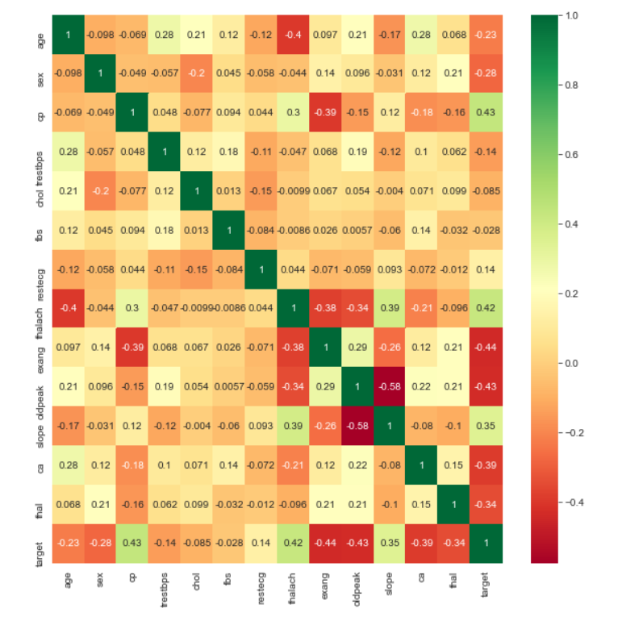
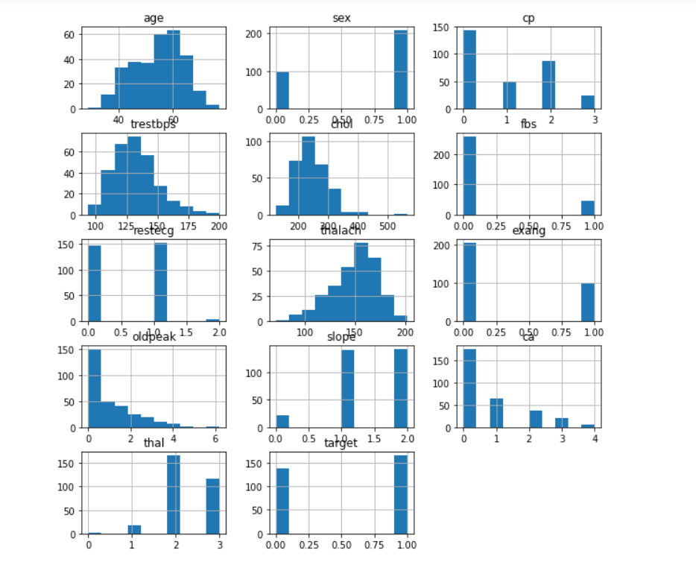
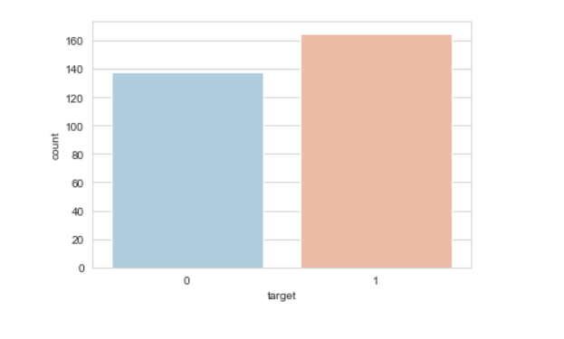
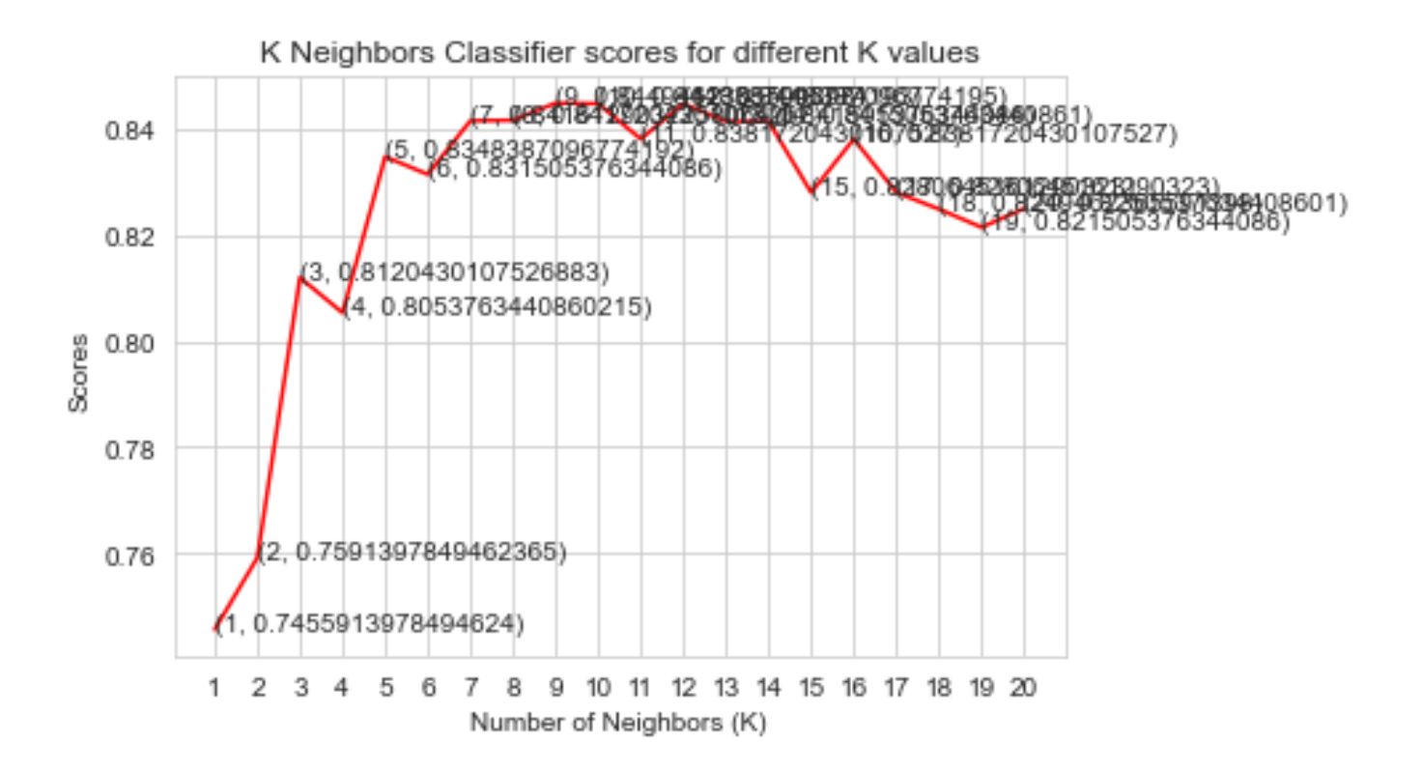
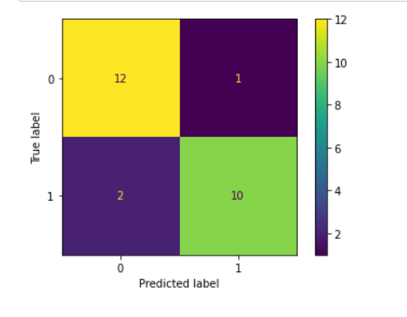
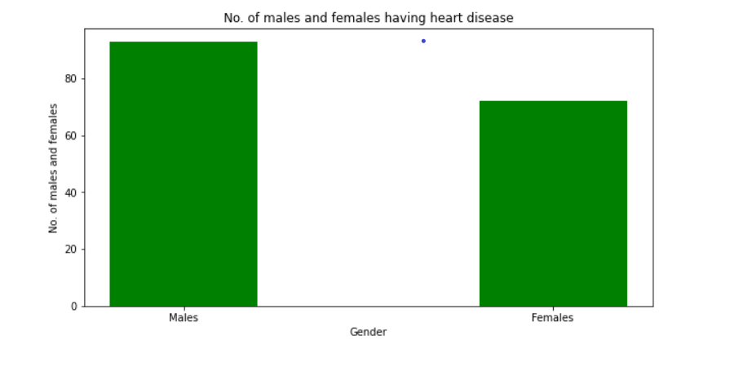
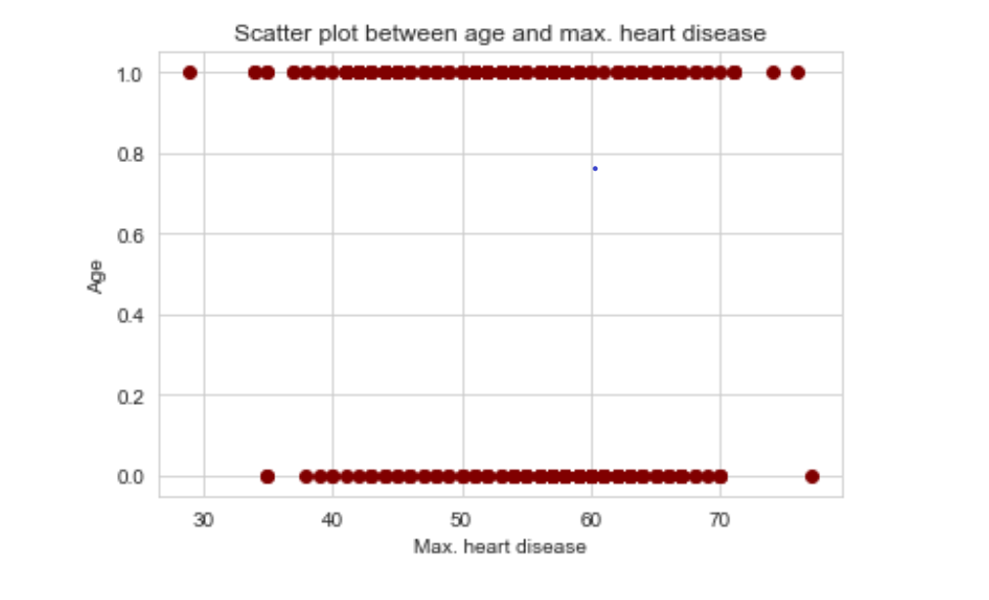
FIGURES AND GRAPHS

Slide 12

INFERENCE
We have plotted the various data scores using the K-NN Classifier and have also calculated the mean score from the derived data points of the K-NN plot. The mean score from the K-NN graph is 82.50%. We've also plotted bar graph between the number of males and females prone to heart disease and a scatter plot between Age and Maximum Heart rate.We can infer from the K-NN program code that K-NN doesn’t work well with large datasets and does not work well with big dimensional data because it is hard to calculate the distance between each data point which is the drawback of the algorithm.

Slide 13

CONCLUSION
This project aims to predict the disease on the basis of the symptoms. It is designed in such a way that it takes input from the user produces the requires output data ,i.e, prediction of heart disease.
We have plotted K-NN graphs, bar graph of number of males and females prone to heart disease and scatter plot between age and sex.
In conclusion, for disease risk modelling, the accuracy of risk prediction depends of the diversity feature of the given dataset.

